Slide 1



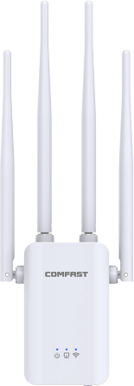

300Mbps
EU/US Plug
Wireless
Repeater
AP
Repeater
Router
CF-WR304S V2
Chipset
MT7628KN
Antenna 4*3dBi External Antenna(Fixed)
Wireless Standard
IEEE802.11b/g/n
Transmission Rate 2.4GHz: 300Mbps
Output Power (Max): 80mW(19dBm)
Receiver Sensitivity (Min): -96dBm
Frequency: 2.412~2.472GHz
RF Parameters
Button
1*WPS/RST Button
Physical
Ports
1*10/100Mbps LAN/WAN Rj45 Ethernet Port
Indicator
Power, Network, WiFi
Power
Power: 100~240V, 50/60HZ
Plug: EU/US Plug
Working Mode AP, Repeater, Router
Case
Plastic Case (ABS Material)
Physical Features Size: 247*86*48MM
Working Temperature: 0℃~40℃
Storage Temperature: -40℃~70℃
Working Environment
Working Humidity: 10%~90%RH Non-condensing
Storage Humidity: 5%~90%RH Non-condensing

